Slide 1


Real-Estate Analysis
Notes:
hyfyjfkjufuyydkugkg

Slide 2
BUSINESS PROBLEM
Lot of houses which got renovated in couple of years seems to be more profitable in the market.

Slide 3
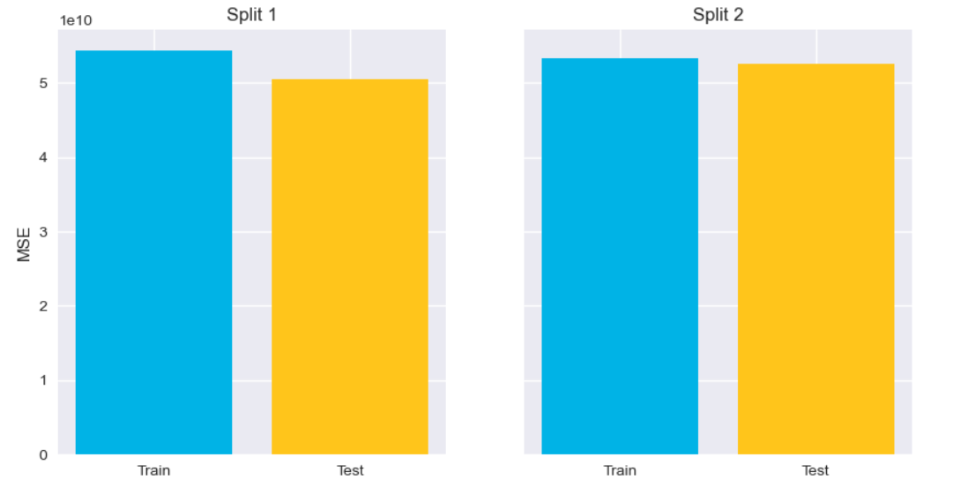
ANALYSIS METHODOLOGY
A proper sample has been taken from the whole population to check the relationship of renovation on the price of the houses.
Notes:
I have removed the unnecessary datas from the table sort the values if there was any missing parameters . Several iteration has been performed to normalize the data and get a more appropriate result We have done ytest on the sample to get a better result sample has been divided into two parts and we did the analysis on both . At the end a plot has been created to visualize the analysis in a simpler way

Slide 4
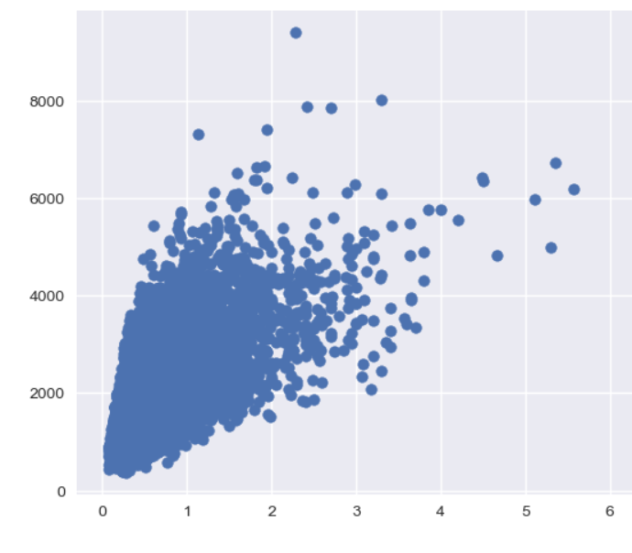
VISUALIOSATION
Price
Renovation years
Notes:
The price vs renovated years has been taken and by the help of the scatter plot a linear relationship has been spotted between these two parameters

Slide 5
CONCLUSION
There is a linear relationship between the price and the renovated house. So, it can be concluded that the price will be higher if the house is renovated in the recent years.
Notes:
It has recommended that real estate agents can profit a lot by renovating the houses

